Slide 1

Better Tools for a Better Life
Notes:
Hello everyone and welcome to today’s webinar: ‘Better Tools for a Better Life: The best editor and debugger tools for your job.’

Slide 2

Franklin Webber
Training and Technical Content Lead
US Army SGT - Radio/COMSEC Repair (35E)
Tech Support
Quality Assurance
Software Developer Eng. in Test
Software Developer
Instructor / Trainer
Ceci n'est pas un entraîneur
Notes:
My name is Franklin Webber. I'm a training lead here at Chef and I’m honored that you chose to be a part of this session today.

Slide 3
You
Chef Cookbook Author
Smart, intelligent, and funny
Compose, edit, debug, run or review Chef code
Realizing that you spend a lot more time in your editor than you used to
Not too familiar with Ruby automation tools

Slide 4
Schedule
NOW – Housekeeping
@ 5 min – Why Are Your Tools Important
@ 10 min – Slides & Live Demonstration
@ 45 min – Questions
@ 55 min – Resources and Wrap-up
Notes:
I have a couple of housekeeping items to cover quickly before we get started.

Slide 5
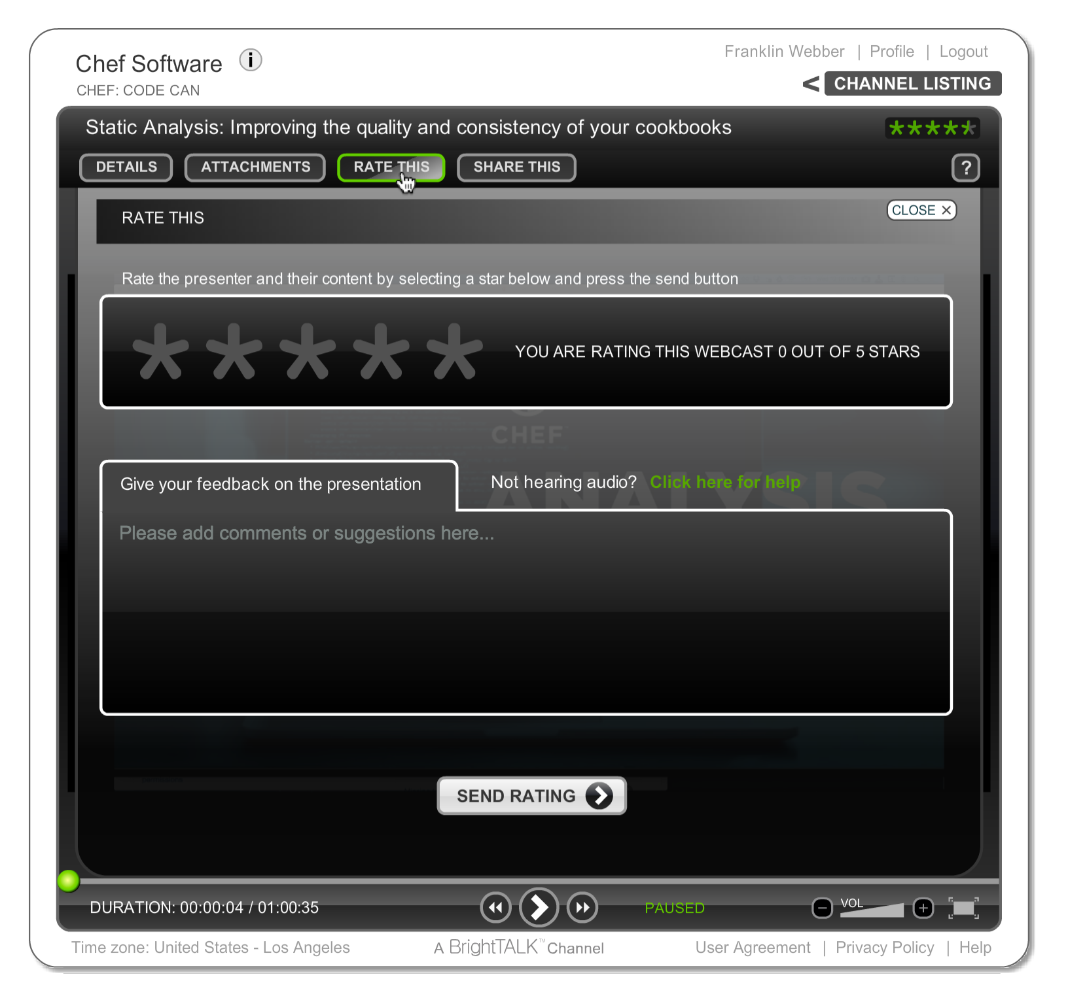
Let Us Know What You Think
"Ask a Question" and I will answer it.
"Rate This" presentation to leave your feedback and help me do my work better.
Email me at franklin@chef.io
Notes:
We’d love to hear from you during today’s presentation. I’ll be answering questions at the end of the session, so please feel free to send those along using the ‘Ask a Question’ tab on the top of your screen.

Slide 6

Was this Valuable to You?
Share it with your professional and social networks.
Notes:
Today’s webinar will be available on demand after the live session, accessible through the same link you’re using now.

Slide 7
Better Tools for a Better Life
Notes:
Hello everyone and welcome again to today’s webinar: ‘Better Tools for a Better Life: The best editor and debugger tools for your job.’

Slide 8
Remembering The Old Days
Addressed an issue or implemented a new feature
Deployed to development
Verified the code by ad hoc verification
Deployed to staging
Verified the code by ad hoc verification
Deployed to production
make change
ad hoc verification
upload cookbook
run chef-client
provision machine
bootstrap machine

Slide 9
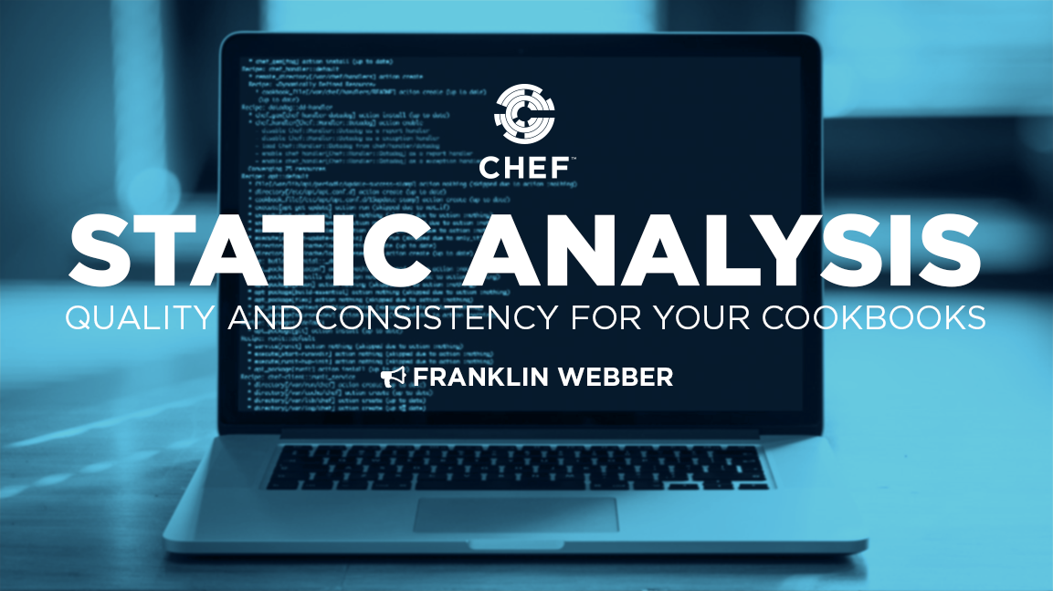
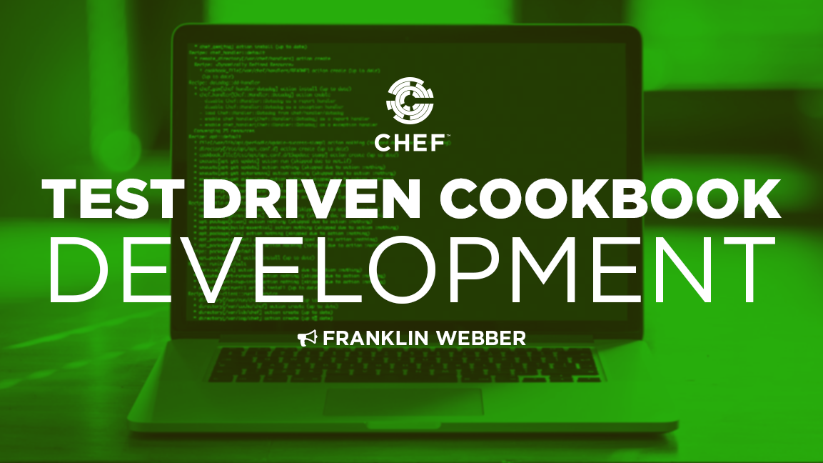
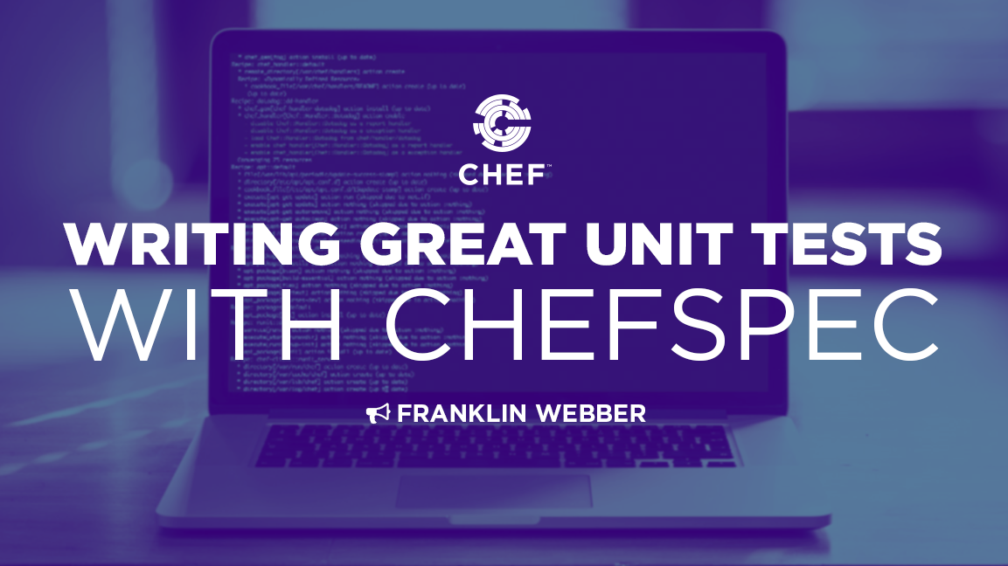
The Promise of Speed and Confidence
chef.io/webinars/?commid=175731
chef.io/webinars/?commid=191263
chef.io/webinars/?commid=194483
Analyzing your code with FoodCritic and RuboCop to ensure your code is correct and adheres to team or community standards
Testing your recipes in cookbooks, with Test Kitchen, against multiple test instances saving you from practicing in production.
ChefSpec allows you to verify your changes in seconds so that you can get feedback on your work fast.

Slide 10
Out with the Old and In with the New
make change
make change
ad hoc verification
upload cookbook
run chef-client
provision machine
automated verification
run testing tools
bootstrap machine

Slide 11
All This New Complexity When Making a Change
Write a unit test
Run Unit Tests
Specify a rule for FoodCritic to enforce / ignore
Specify a rule for Rubocop to enforce / ignore
Add a Test Suite to the Kitchen Configuration
Commit and Push changes Version Control
make change
automated verification
run testing tools

Slide 12
More Commands to Know and Run
chef.io/webinars/?commid=175731
chef.io/webinars/?commid=191263
chef.io/webinars/?commid=194483
> foodcritic
> rubocop
> kitchen list
> kitchen create
> kitchen converge
> kitchen verify
> kitchen test
> kitchen destroy
> rspec --init
> rspec
> rspec spec/unit/rec...

Slide 13
More Languages to Know and Run
chef.io/webinars/?commid=175731
chef.io/webinars/?commid=191263
chef.io/webinars/?commid=194483
YAML
Foodcritic DSL
Ruby
InSpec
ServerSpec
RSpec
Ruby
ChefSpec
RSpec
Ruby

Slide 14
Present Day
Delivering correct code that meets team standards and preserves existing functionality across all required platforms but ... at a much slower pace, with a lot more code to define, commands to execute and ultimately not feeling very confident; maybe even feeling more insecure about the code you develop.

Slide 15
Present Day
Delivering correct code that meets team standards and preserves existing functionality across all required platforms but ... at a much slower pace, with a lot more code to define, commands to execute and ultimately not feeling very confident; maybe even feeling more insecure about the code you develop.

Slide 16
Agenda
Exploring Features of a Modern Editor
Capturing Common Tasks with Rake
Automating Execution with Guard
Debugging with Pry
Questions
Further Resources

Slide 17
The Features that Define a Modern Editor
Syntax Highlighting
Project / Folder View
Code Snippets / Plugin Support
Keyboard Shortcuts

Slide 18
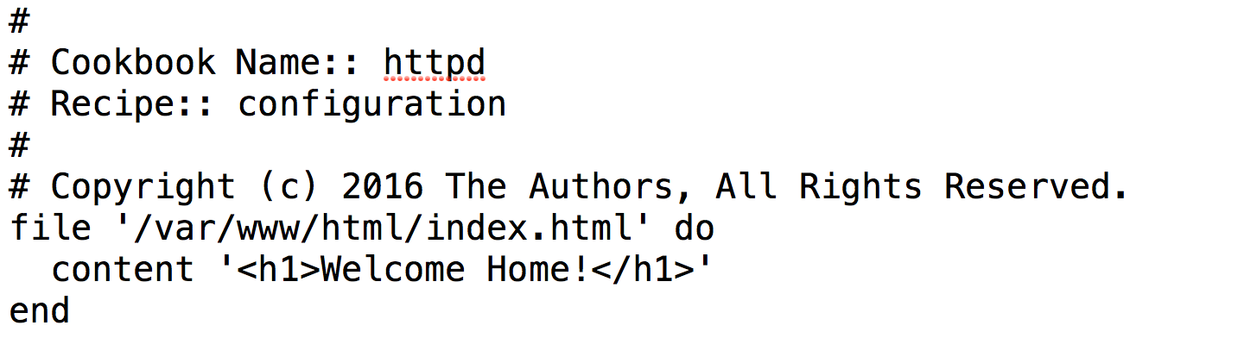
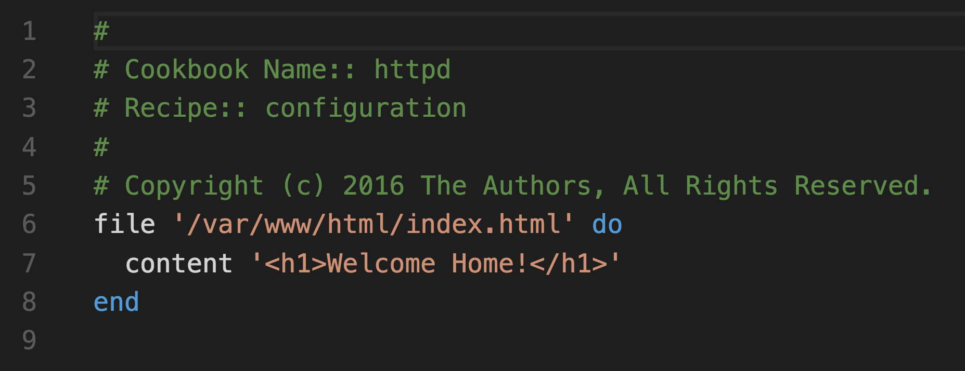
The Importance of Reading Code
Syntax Highlighting
Project / Folder View
Code Snippets / Plugin Support
Keyboard Shortcuts

Slide 19
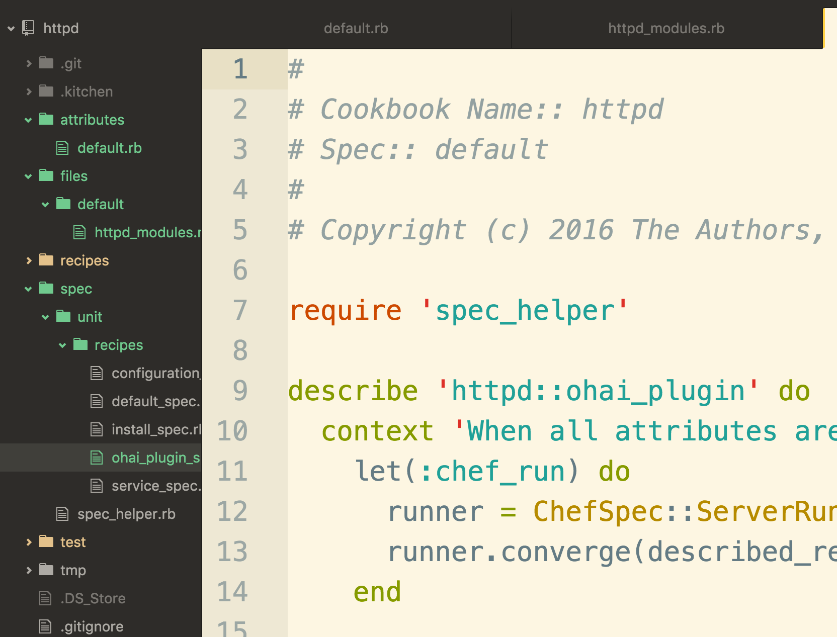
All the Files You Need, All in One Place
Syntax Highlighting
Project / Folder View
Code Snippets / Plugin Support
Keyboard Shortcuts

Slide 20
Little Effort with Maximum Results
Syntax Highlighting
Project / Folder View
Code Snippets / Plugin Support
Keyboard Shortcuts

Slide 21
Keeping Your Fingers in the Flow
Syntax Highlighting
Project / Folder View
Code Snippets / Plugin Support
Keyboard Shortcuts

Slide 22
Some Modern Editors
vim
emacs
Atom
Visual Studio Code
Notepad++
Sublime Text
RubyMine

Slide 23
Agenda
Exploring Features of a Modern Editor
Capturing Common Tasks with Rake
Automating Execution with Guard
Debugging with Pry
Questions
Further Resources

Slide 24
Rake
A make-like build utility for Ruby. This tool is packaged with the Chef Development Kit (Chef DK).
It allows you to capture tasks in a Ruby based Domain Specific Language (similar to Chef).
https://github.com/ruby/rake

Slide 25
Defining Rake Tasks
https://github.com/chef-cookbooks/ark/blob/master/Rakefile
Define tasks Rubocop and Foodcritic
Define task for ChefSpec
Define task for Test Kitchen

Slide 26
Adding a Rake Task for Foodcritic
~/httpd/Rakefile
require 'foodcritic'
desc 'Run Chef style checks'
FoodCritic::Rake::LintTask.new(:chef)

Slide 27
Adding a Rake Task for Rubocop
~/httpd/Rakefile
require 'foodcritic'
desc 'Run Chef style checks'
FoodCritic::Rake::LintTask.new(:chef)
require 'rubocop/rake_task'
desc 'Run Ruby style checks'
RuboCop::RakeTask.new(:ruby)

Slide 28
Viewing the New Rake Commands
> chef exec rake --tasks
WARNING: Nokogiri was built against LibXML version 2.9.2, but has dynamically loaded 2.9.3
rake chef # Lint Chef cookbooks
rake ruby # Run Ruby style checks
rake ruby:auto_correct # Auto-correct RuboCop offenses

Slide 29
Running the Rubocop Rake Task
> chef exec rake ruby
WARNING: Nokogiri was built against LibXML version 2.9.2, but has dynamically loaded 2.9.3
Running RuboCop...
Inspecting 17 files
.C.C...........C.
Offenses:

Slide 30
Defining Rake Tasks
https://github.com/chef-cookbooks/ark/blob/master/Rakefile
Define tasks Rubocop and Foodcritic
Define task for ChefSpec
Define task for Test Kitchen

Slide 31
Adding a Rake Task for ChefSpec
require 'rubocop/rake_task'
desc 'Run Ruby style checks'
RuboCop::RakeTask.new(:ruby)
require 'rspec/core/rake_task'
desc 'Run ChefSpec examples'
RSpec::Core::RakeTask.new(:spec)

Slide 32
Viewing the New Rake Commands
> chef exec rake --tasks
WARNING: Nokogiri was built against LibXML version 2.9.2, but has dynamically loaded 2.9.3
rake chef # Lint Chef cookbooks
rake ruby # Run Ruby style checks
rake ruby:auto_correct # Auto-correct RuboCop offenses
rake spec # Run ChefSpec examples

Slide 33
Running the New ChefSpec Rake Task
> chef exec rake spec

Slide 34
Defining Rake Tasks
https://github.com/chef-cookbooks/ark/blob/master/Rakefile
Define tasks Rubocop and Foodcritic
Define task for ChefSpec
Define task for Test Kitchen

Slide 35
Adding a Rake Task for ChefSpec
require 'rspec/core/rake_task'
desc 'Run ChefSpec examples'
RSpec::Core::RakeTask.new(:spec)
require 'kitchen/rake_tasks'
desc 'Run Test Kitchen integration tests'
Kitchen::RakeTasks.new

Slide 36
Viewing the New Rake Commands
> chef exec rake --tasks
rake chef # Lint Chef cookbooks
rake kitchen:all # Run all test instances
rake kitchen:default-centos-71 # Run default-centos-71 test...
rake ruby # Run Ruby style checks
rake ruby:auto_correct # Auto-correct RuboCop offenses
rake spec # Run ChefSpec examples

Slide 37
Running the New Kitchen Rake Task
> chef exec rake kitchen:default-centos-71

Slide 38
Defining Rake Tasks
https://github.com/chef-cookbooks/ark/blob/master/Rakefile
Define tasks Rubocop and Foodcritic
Define task for ChefSpec
Define task for Test Kitchen

Slide 39
Agenda
Exploring Features of a Modern Editor
Capturing Common Tasks with Rake
Automating Execution with Guard
Debugging with Pry
Questions
Further Resources

Slide 40
Guard
Guard is a command line tool to easily handle events on file system modifications.
It allows you to execute tasks when files within your cookbook change.
https://github.com/guard/guard

Slide 41
Installing the Guard Gems
> chef gem install guard
> chef gem install guard-rspec
> chef gem install guard-kitchen
> chef gem install guard-rubocop
> chef gem install guard-foodcritic

Slide 42
Installing the Guard Gems
> chef exec guard init rspec
> chef exec guard init kitchen
> chef exec guard init rubocop
> chef exec guard init foodcritic

Slide 43
Viewing the Guardfile
~/httpd/Guardfile

Slide 44
Agenda
Exploring Features of a Modern Editor
Capturing Common Tasks with Rake
Automating Execution with Guard
Debugging with Pry
Questions
Further Resources

Slide 45
Pry
Pry is a powerful alternative to the standard IRB shell for Ruby. It features syntax highlighting, a flexible plugin architecture, runtime invocation and source and documentation browsing.
http://pryrepl.org

Slide 46
What if We Made a Typo?
While implementing the node attribute what if made a mistake?
Notes:
In the process of implementing the use of the node attribute in the recipe or in the attributes file we could have made a mistake. We proved that the examples would have caught the error.
What if an error occurred and we were unable to find it? Occasionally you will implement a change wrong and then find yourself staring at the failing expectations wondering what is wrong.

Slide 47
Typos Like This One Will Waste Time
~/httpd/attributes/default.rb
default['htpd']['package_name'] = 'httpd'
Notes:
This is a simple typo that the examples would catch but when it comes time to find and fix the issue, our eyes may not immediately catch it. We may think the error lies somewhere in the recipe. If we cannot find it we keep running the tests and wondering what is going wrong.

Slide 48
Mental Model vs Actual Model
Faster feedback helps us build a greater mental model of the actual execution model. Tests that we define help strengthen it. However, tests are not very interactive as they are more like experiments. What we want is the ability to pause execution and look around.
Notes:
This is a situation where our mental model of the state of things is different than the actual model of execution. The benefit of tests is that it allows us to express the expectations about the model of how the execution should run. Testing is like a experiment: setup; execute; verify.
That feedback is not very interactive. There are moments where you want to be to stop the execution at a particular point and ask some questions.

Slide 49
Pry a Debugger
Pry is a Ruby debugger that allows you to define break points. These breakpoints allow you to pause operation and interact with the current process being able to interrogate the current state of the system.
http://pryrepl.org
Notes:
This situation is one in which we want to use a tool called a debugger. Debuggers allow us to set up points where the execution flow will pause and allow us, the user, to interact with the system within the current context of where the execution paused.
Ruby has a well supported debugger project named 'Pry'. 'Pry' is a Ruby gem that is already installed in the Chef Development Kit (Chef DK).

Slide 50
Setup a Break Point
Time to make trouble for ourselves.
Mutate the code and add the breakpoint
Execute the tests to cause the breakpoint to trigger
Remove the breakpoint and restore the code
Notes:
To explore using Pry we need to create an issue for ourselves to troubleshoot. Doing so will allow us to see some of the power of Pry.

Slide 51
Creating a Typo in the Defined Attribute
~/httpd/attributes/default.rb
default['htpd']['package_name'] = 'httpd'
Notes:
This is a simple typo that the examples would catch but when it comes time to find and fix the issue, our eyes may not immediately catch it. We may think the error lies somewhere in the recipe. If we cannot find it we keep running the tests and wondering what is going wrong.

Slide 52
Adding a Break Point in the Recipe
~/httpd/recipes/install.rb
#
# Cookbook Name:: httpd
# Recipe:: install
#
# Copyright (c) 2016 The Authors, All Rights Reserved.
require 'pry'
binding.pry
package node['httpd']['package_name']
Notes:
To use Pry you first have to specify a require statement. The require here will look for a file name 'pry' give up on finding it locally and then look for the file inside all of the installed gems.
After the Pry code is loaded we access a method named 'binding' and then ask it to run 'pry'. 'binding' is a special method in Ruby that is like gaining access to the DNA of the current context. Pry, after it is loaded, will add the 'pry' method to the binding object to allow us the ability to setup a break point.
Wherever we want to set a breakpoint we can place these two lines.

Slide 53
Setup a Break Point
Time to pry into the code and see what it is going on.
Mutate the code and add the breakpoint
Execute the tests to cause the breakpoint to trigger
Remove the breakpoint and restore the code
Notes:
The breakpoint cannot break itself. We need to execute the code to cause the execution to pause. The best way to do that is execute the tests that we have defined.

Slide 54
Executing the Test to Initiate Pry
> chef exec rspec spec/unit/recipes/install_spec.rb
From: /tmp/d20161026-17430-19i8bee/cookbooks/httpd/recipes/install.rb @ line 7 Chef::Mixin::FromFile#from_file:
2: # Cookbook Name:: httpd
3: # Recipe:: install
4: #
5: # Copyright (c) 2016 The Authors, All Rights Reserved.
6: require 'pry'
=> 7: binding.pry
8:
9: package node['httpd']['package_name']
# ... CONTINUES ON THE NEXT SLIDE ...
Notes:
We can execute the tests for the install specification so that it will process that recipe. After a moment of normal execution the flow will pause and you will be shown where in the code the execution has paused. Along the top is the name of the file with the line number where it is paused. Below is a source code listing line-by-line before and after the breakpoint.

Slide 55
Identifying Pry's Interactive Prompt
> chef exec rspec spec/unit/recipes/install_spec.rb
# ... CONTINUED FROM THE PREVIOUS SLIDE ...
5: # Copyright (c) 2016 The Authors, All Rights Reserved.
6: require 'pry'
=> 7: binding.pry
8:
9: package node['httpd']['package_name']
[1] pry(#<Chef::Recipe>)>
Notes:
Below the summary of the code around the breakpoint is a prompt. Pry launches a Read-Eval-Print-Loop (REPL). At this prompt we can type in a number of commands and any Ruby code.

Slide 56
Asking Pry for Help
[1] pry(#<Chef::Recipe>)> help
Help
help Show a list of commands or information about a specific command.
Context
cd Move into a new context (object or scope).
find-method Recursively search for a method within a class/module or the curr...
ls Show the list of vars and methods in the current scope.
pry-backtrace Show the backtrace for the pry session.
raise-up Raise an exception out of the current pry instance.
reset Reset the repl to a clean state.
To escape the help menu, type in :q
Notes:
The most important provided by Pry is probably the 'help' command. Within the results of this you will see all the commands available. The help will display in a scrolling page like a Linux man page. To escape out of the help output and return to being able to type in commands you will need to enter the keystrokes ':q'
Instructor Note: This content introduces Pry but will not go into explaining all of the different features.

Slide 57
Executing Any Code as You Would in a Recipe
[2] pry(#<Chef::Recipe>)> node['httpd']
=> nil
Notes:
Back at the prompt you can enter in any code that you would normally write within the recipe. In this case we can start to examine the node object to see that the node object does not have the top-level attribute set as we expected.

Slide 58
Exploring the Different Node Attributes
[3] pry(#<Chef::Recipe>)> node['htpd']
=> {"package_name"=>"httpd"}
Notes:
This interactive session allows us to verify the actual state quickly. When it does not match our mental model we can try multiple hypothesizes quickly. Here we may return back to the attribute file and copy the text within the attribute and attempt this again and see what is actually going on.
We see in this example that

Slide 59
Halting the Execution of the Test Immediately
[4] pry(#<Chef::Recipe>)> exit!
Notes:
When you are satisfied with what you have discovered it is time to exit. Pry provides two versions of exit:
'exit' which will resume the execution and stop at any other breakpoints along the way.
'exit!' which halts the execution immediately and returns you to your shell.
In this situation we want to halt the execution immediately as we have discovered the issue.

Slide 60
Setup a Break Point
Time to pry into the code and see what it is going on.
Mutate the code and add the breakpoint
Execute the tests to cause the breakpoint to trigger
Remove the breakpoint and restore the code
Notes:
Now that we have discovered the issue in this scenario it is time to remove the breakpoint and restore the attributes code back to its correct state.

Slide 61
Removing the Break Point from the Recipe
~/httpd/recipes/install.rb
#
# Cookbook Name:: httpd
# Recipe:: install
#
# Copyright (c) 2016 The Authors, All Rights Reserved.
require 'pry'
binding.pry
package node['httpd']['package_name']
-

Slide 62
Fixing the Typo in the Attribute
~/httpd/attributes/default.rb
default['httpd']['package_name'] = 'httpd'
Notes:
This is a simple typo that the examples would catch but when it comes time to find and fix the issue, our eyes may not immediately catch it. We may think the error lies somewhere in the recipe. If we cannot find it we keep running the tests and wondering what is going wrong.

Slide 63
Setup a Break Point
Time to pry into the code and see what it is going on.
Mutate the code and add the breakpoint
Execute the tests to cause the breakpoint to trigger
Remove the breakpoint and restore the code
Notes:
This small exercise focused on a small subset of what is possible with Pry. It is a powerful tool that will aid you in understand the execution of the system much faster than tests alone.

Slide 64
Pry is Ruby
Pry can be employed in any Ruby code that is executed to help paused the execution and allow you inspect the code.

Slide 65
Agenda
Exploring Features of a Modern Editor
Capturing Common Tasks with Rake
Automating Execution with Guard
Debugging with Pry
Questions
Further Resources

Slide 66
Let Us Know What You Think
Email me at franklin@chef.io
"Rate This" presentation to leave your feedback and help me do my work better.

Slide 67
Q&A
What questions can I answer for you?

Slide 68
Agenda
Exploring Features of a Modern Editor
Capturing Common Tasks with Rake
Automating Execution with Guard
Debugging with Pry
Questions
Further Resources

Slide 69
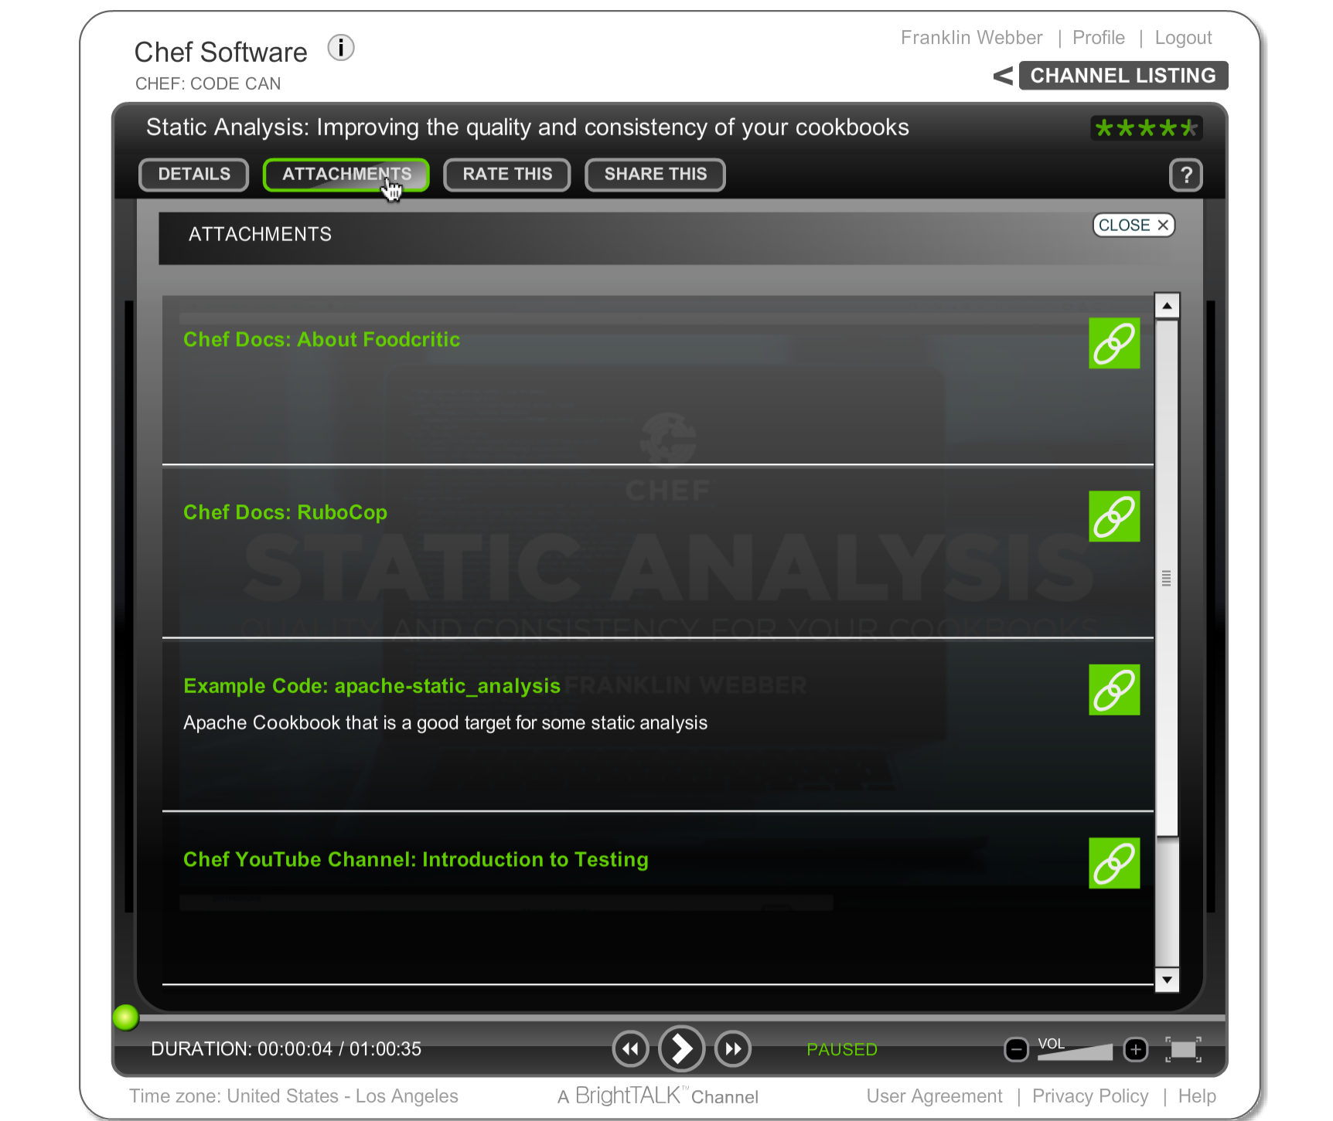
BrightTALK Attachments
All of the resources I am going to provide you can be found under "Attachments".

Slide 70

The Joy of Automating!
getchef @ YouTube

Slide 71
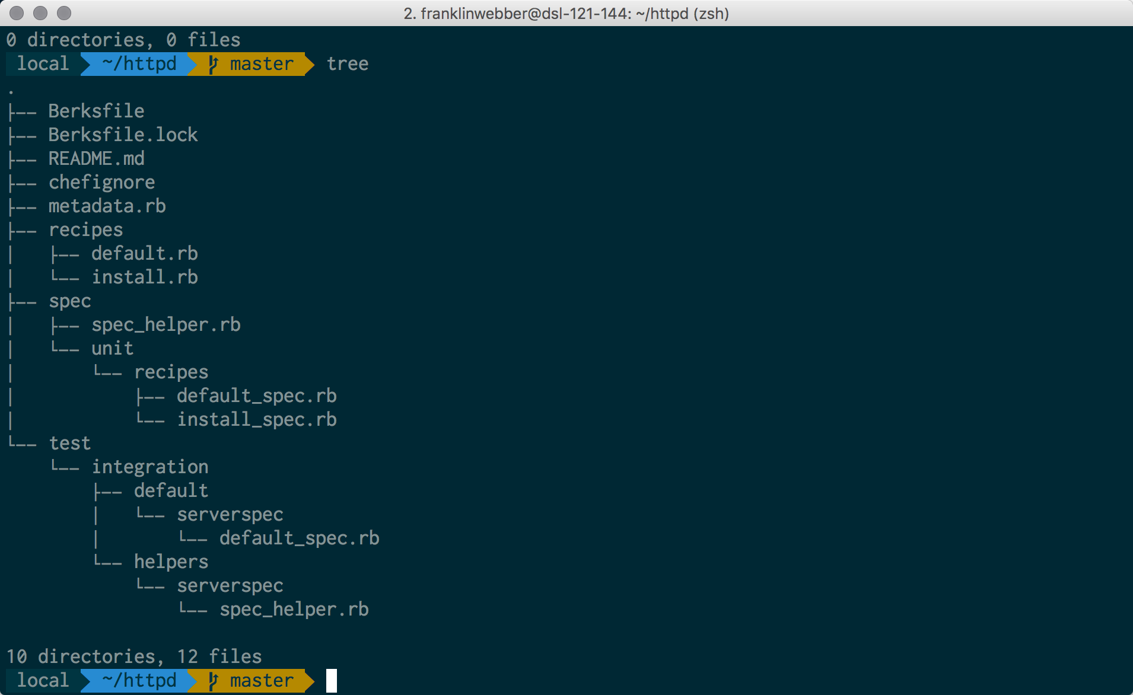
My Terminal
Mac OSX
iTerm2
Oh My Zsh
Agnoster Theme
Powerline Patched Font

Slide 72
Agenda
Exploring Features of a Modern Editor
Capturing Common Tasks with Rake
Automating Execution with Guard
Debugging with Pry
Questions
Further Resources

